Slide 1
Culture and Sociaty
Muhammad Abdullah 4208 Maaz Tawkali 4089
Misbah 4090
http://www.free-powerpoint-templates-design.com

Slide 2

Table of Contents
01
Introduction
02
Examples Of Sociaties
03
Elements Of Culture
04
Interaction between Society and Culture
05
Conclusion

Slide 3
INTRODUCTIN

Slide 4
Introduction
Culture refers to norms and practices that are passed down for generations, while society associates people because of their culture. Culture provides guidelines on how people should live, while society determines how those cultures are structured.
Society and culture are closely related. Culture considers various aspects of society like language, technology, and norms, whereas society involves people who share a common culture. It is through culture that people understand themselves and relate to societal norms. Therefore, these terms are entirely different but associated. Sociologists use these terms to explain some concepts in social life.

Slide 5
Examples of Sociaty

Slide 6
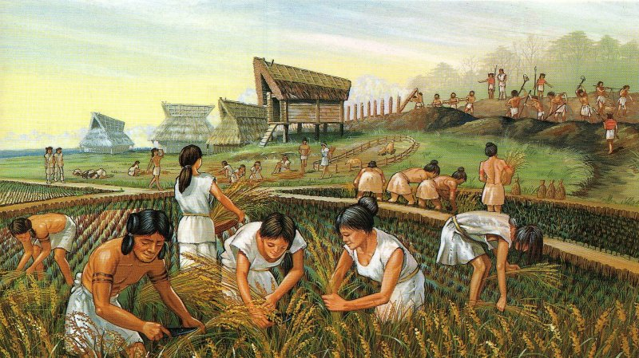
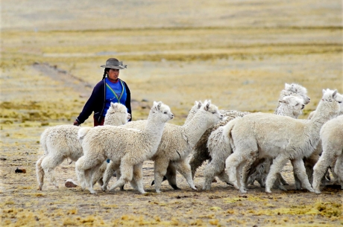
Agrarian Society
Agricultural societies use technological advances to cultivate crops (especially grains like wheat, rice, corn, and barley) over a large area. Sociologists use the phrase Agricultural Revolution to refer to the technological changes that occurred as long as 8,500 years ago that led to cultivating crops and raising farm animals. Increases in food supplies then led to larger populations than in earlier communities. Ancient civilizations like the Mayans, who built complex agricultural systems and organized societies.
Modern PowerPoint Presentation
Pastoral Sociaty:
Members of pastoral societies, which first emerged 12,000 years ago, pasture animals for food and transportation. Pastoral societies still exist today, primarily in the desert lands of North Africa where horticulture and manufacturing are not possible. Pastoral societies allow certain of its members (those who are not domesticating animals) to engage in nonsurvival activities. Traders, healers, spiritual leaders, craftspeople, and people with other specialty professions appear.

Slide 7

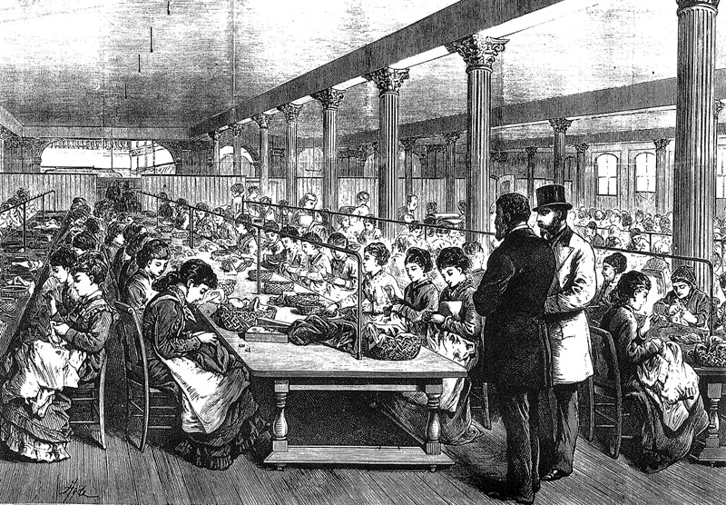
Feudal societies
Feudalism, prevalent from the 9th to 15th centuries, was a land-based societal structure. Vassals, unlike modern farmers, were obligated to cultivate their lord's land. In exchange for military protection, lords exploited peasants, extracting food, crops, crafts, homage, and services. Feudalism's caste system often extended across generations, with peasant families tending to their lord's land for centuries. Between the 14th and 16th centuries, a new economic system emerged, gradually supplanting feudalism. Capitalism, characterized by free market competition and private ownership of production, began to take hold.
Modern PowerPoint Presentation
Industrial Sociaty:
Industrial societies are based on using machines
(particularly fuel‐driven ones) to produce goods.
Sociologists refer to the period during the 18th
century when the production of goods in mechanized factories began as the Industrial Revolution.
The Industrial Revolution appeared first in Britain,
and then quickly spread to the rest of the world.

Slide 8
Culture

Slide 9
Culture refers to the shared beliefs, values, customs, behaviors, and artifacts that characterize a particular group or society. It encompasses the way of life and the learned patterns of thinking, feeling, and behaving that are passed down from one generation to another. Culture influences various aspects of human life, including communication, social interactions, traditions, art, cuisine, clothing, and more. Here are some key points about culture:
Diversity: Cultures around the world vary greatly, reflecting the diversity of human experiences, histories, and environments. Each culture has its own unique practices and perspectives.
Elements of Culture: Culture comprises several elements, including language, religion, social norms, customs, rituals, arts, music, literature, cuisine, clothing, architecture, and technology.
Learned and Shared: Culture is learned through socialization within a community or society. It is transmitted from one generation to the next through family, education, media, and other social institutions. Culture is also shared among members of a group, influencing their behavior and shaping their identity.
Multifaceted: Culture is multifaceted and complex. It involves both tangible and intangible aspects, ranging from material artifacts like tools and buildings to abstract concepts like beliefs and values.
Dynamic and Adaptive: Cultures are not static but rather evolve and adapt over time in response to social, economic, political, and technological changes. Cultural change can occur through contact with other cultures, globalization, migration, and other factors.
Influence on Behavior: Culture significantly influences individual and collective behavior. It shapes how people communicate, dress, eat, celebrate, and interact with others. It also impacts social norms, gender roles, attitudes, and beliefs.

Slide 10
Elements of Culture
Language and Communication:
Language is a fundamental aspect of culture and plays a vital role in communication and expression. Different languages reflect unique worldviews, cultural values, and social structures.
Values and Beliefs:
Values and beliefs shape cultural norms, attitudes, and social expectations.
Norms and Customs:
Norms can vary across cultures and influence how individuals interact, dress, behave, and communicate. Customs refer to specific practices, rituals, or traditions that are characteristic of a particular culture or society.
Symbols and Artifacts:
Symbols and artifacts play a role in communication, identity formation, and the preservation of cultural heritage.

Slide 11
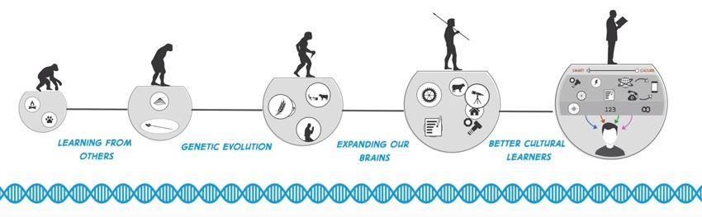
Cultural Evolution plays a significant role in shaping various aspects of human psychology, including our brains, motivations, hormonal responses, intuitive reactions, beliefs, worldviews, and preferences. It influences the immense psychological variation observed across the globe. Here's a summary of how cultural evolution impacts these aspects:
Psychology: Cultural evolution molds our psychological processes by shaping our cognitive abilities. It influences how we perceive, interpret, and interact with the world around us.
Hormonal Responses: Cultural factors can impact hormonal responses, such as the release of stress hormones or oxytocin, which are influenced by social interactions and cultural norms. Cultural practices and socialization can affect our physiological responses to various stimuli.
Beliefs and Worldviews: Cultural evolution plays a crucial role in shaping our beliefs, worldviews, and ideologies. It determines the cultural narratives, religious beliefs, moral values, and social norms that are transmitted and internalized within a society.
Preferences: Cultural evolution shapes our preferences by influencing what is considered desirable, beautiful, or appealing within a particular culture. Cultural factors shape our aesthetic preferences, taste in music, art, food, and other domains.

Slide 12
Interaction
Interaction between Society and Culture
Culture and society are co-existent. one does not or cannot exist without the other. culture and society may have some common elements but the two are not the same; they are not identical. the essential difference is that society is composed of people while culture consists of knowledge, ideas, customs, traditions, folkways, mores, beliefs, skills, institutions, organizations, and artifacts.
Society is the combination of people with different cultures. In the other hand, Culture deal with the behaviours,language,occupation,dressing,eating and festival of a particular people within a geographical area.
The influence of culture on society: The celebration of cultural festivals, like Chinese New Year or Diwali, which shape social practices and bring communities together.
The impact of society on culture: Social changes, such as gender equality movements, can lead to shifts in cultural norms and beliefs.

Slide 13
Conclusion
It is crucial to recognize and appreciate the dynamic nature of society and culture. Society and culture continuously evolve, responding to changes in technology, globalization, and societal shifts. They shape human behavior by providing norms, values, and expectations that guide individuals in their interactions and choices. Moreover, culture plays a significant role in identity formation, as it is transmitted through socialization and influences individuals' beliefs, values, and behaviors.
By understanding the dynamic nature of society and culture, we can better comprehend the complexities of human behavior and the diversity of identities.
Conclusion

Slide 14
Thank you

